Slide 1

Assessment Results Histogram
Ibn Sina National College for Medical Studies
Health Professions Education Center (HPEC)
Program: ………
Course Name: ………
Course Coordinator: ………

Slide 2
Program | …… |  | Grades | Males | Females | Total
Year / Level | … / …
 |  |  | A | … (…%) | … (…%) | … (…%)
Department | …… |  | B | … (…%) | … (…%) | … (…%)
 |  |  | C | … (…%) | … (…%) | … (…%)
Course Title | …… |  | D | … (…%) | … (…%) | … (…%)
 |  |  | F | … (…%) | … (…%) | … (…%)
Ac. Year: 2023 – 24 / Semester: I |  |  | Total | … (100%) | … (100%) | … (100%)

Slide 3
Interpretation and Analysis (see next slide for normal curve abnormalities):
Male |  | Female |  | Average
Normal curve | Yes / No | Normal curve | Yes / No | Normal curve | Yes / No
Skewness | Yes / No | Skewness | Yes / No | Skewness | Yes / No
 | Yes? Direction? - Right ( ) - Left ( ) |  | Yes? Direction? - Right ( ) - Left ( ) |  | Yes? Direction? - Right ( ) - Left ( )
Kurtosis | Yes / No | Kurtosis | Yes / No | Kurtosis | Yes / No
Multimodality | Yes / No | Multimodality | Yes / No | Multimodality | Yes / No
In case of skewness, kurtosis, or multimodality: Possible reasons: - - - Suggested solutions: - - - |  | In case of skewness, kurtosis, or multimodality: Possible reasons: - - - Suggested solutions: - - - |  | In case of skewness, kurtosis, or multimodality: Possible reasons: - - - Suggested solutions: - - -

Slide 4
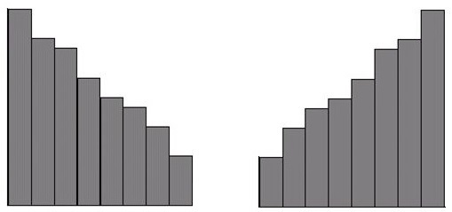
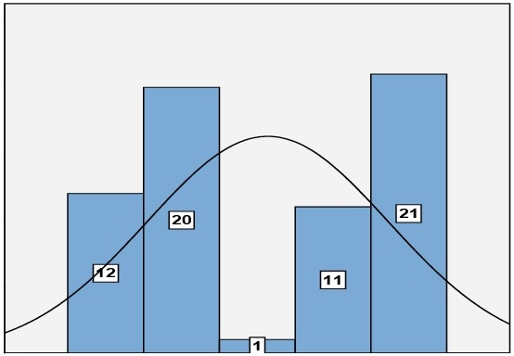
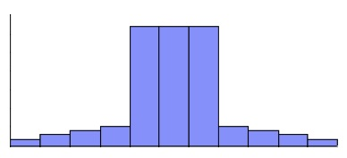
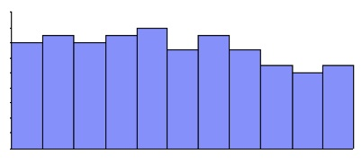
Right or positively skewed
Left or negatively skewed
Skewness
Bimodality
Kurtosis
Kurtosis

